Slide 1
Final Project Presentation
Group 14
April 20, 2016
Walker Maychek
Ilana Wasserman

Slide 2
Project purpose
To create a collaborative way for users to share and connect “layers”
Users would create content on the website, and be able to see and download any other posted layer
Can then modify layer on outside applications
When repost, can link it to the layers from which it came to create a “family history” of the layer
Use Hashtags to provide descriptions of the layers

Slide 3
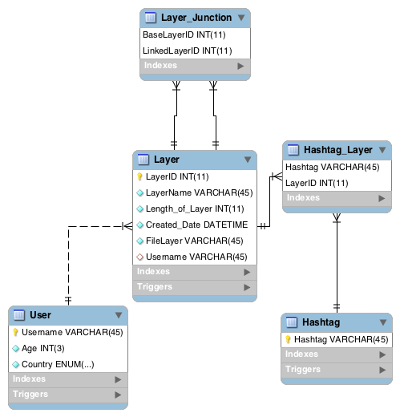
EER Diagram

Slide 4
User interactions
Begin
View, add, or update layer?
View
Add
Update
Adds layer; enters layer details and clicks “Add”.
2
1
Search by layer name or user to views layers; leave search fields empty to view all.
Updates layer; chooses layer, modifies details, and clicks update.
Username recognized?
No
Yes
Enters User details. User saved in db.
Layer saved in database.
End

Slide 5
User interactions (Cont.)
1
Modify Hashtags or Links?
Hashtag
Link
Add or Delete Hashtag?
Neither
Add or Delete Linked Layer?
2
Add
Delete
Add Hashtag to list. Hashtag Layer created in db.
Click “X” to delete Hashtag. Deletes Hashtag Layer from db.
Add
Delete
Add Linked Layer to list. Layer Junction created in db.
Click “X” to delete Linked Layer. Deletes Layer Junction from db.
2

Slide 6
Demonstration

